Slide 1

DELD
Unit 4
Registers and Counters
Electronics Engineering Department

Slide 2
Registers
An Array of Flip-Flops used to store binary information
No. of Flip-Flops will be equal to the no of bits required to store the information
Data can be entered serially or parallely
It can also be used for Data movement
Basically know as shift register, it shifts it output every clock pulse

Slide 3
Types
Serial In Serial Out
Serial In Parallel Out
Parallel In Serial Out
Parallel In Parallel Out
Shift Left
Shift Right

Slide 4
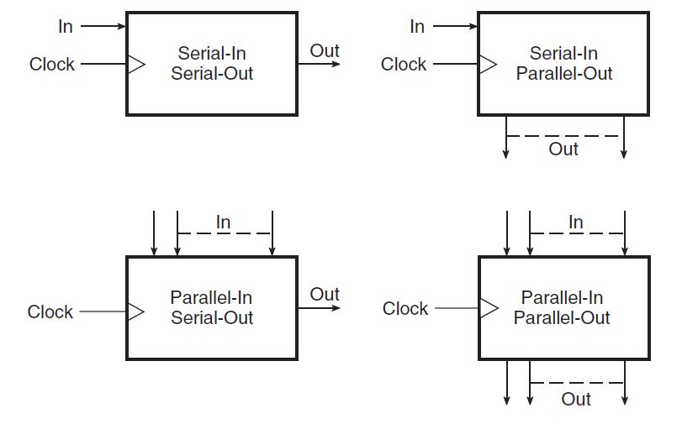
Types

Slide 5
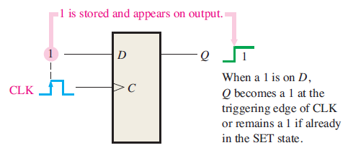
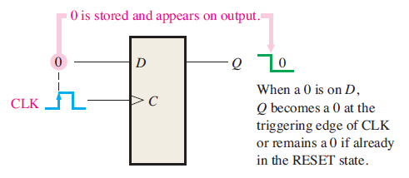
Working Concept

Slide 6
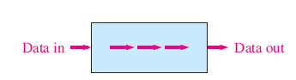
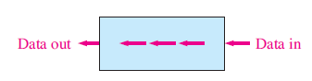
Another Perspective

Slide 7
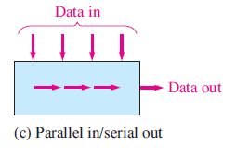
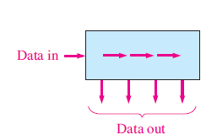

Slide 8
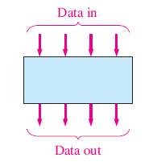
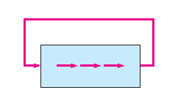
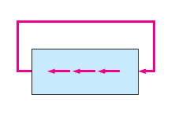

Slide 9
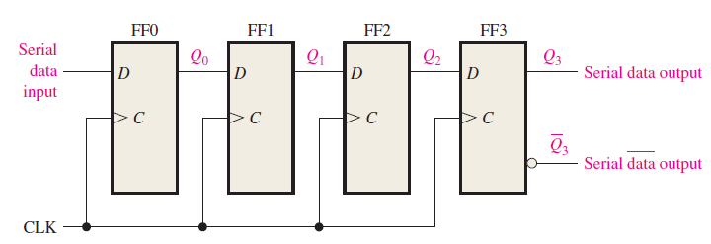
Serial In Serial Out

Slide 10
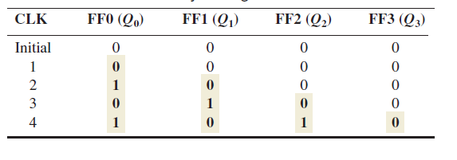
Bit Movement

Slide 11
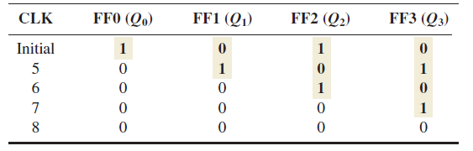
Bit Movement Cont..

Slide 12
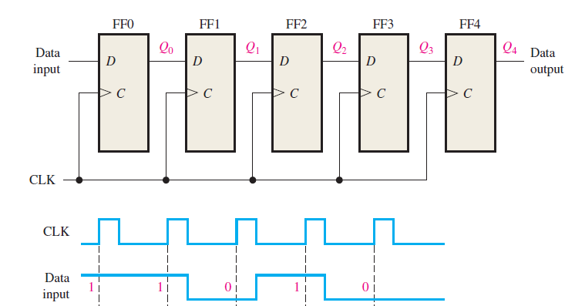
Concept Check

Slide 13
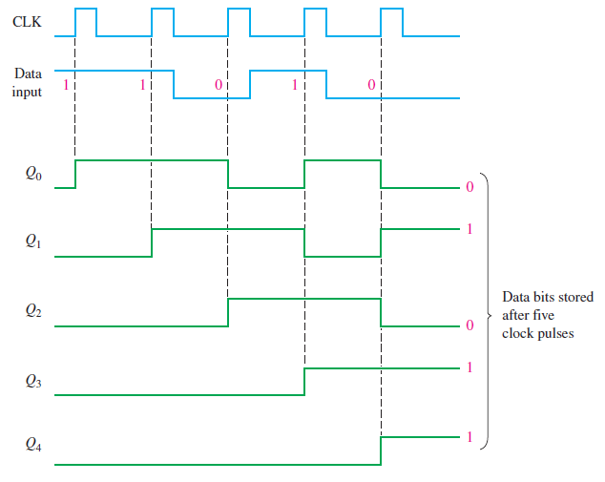
Solution

Slide 14
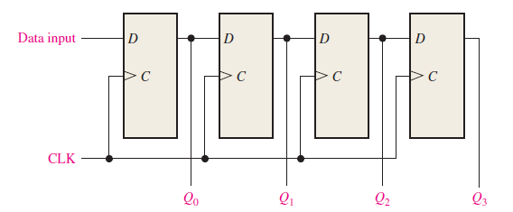
Serial In Parallel Out

Slide 15
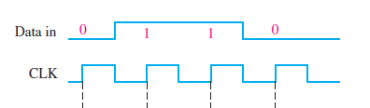
Concept Check

Slide 16
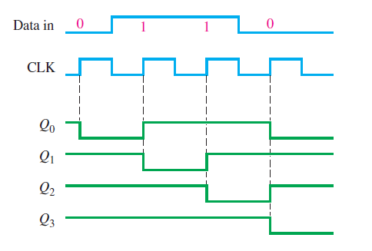
Solution

Slide 17
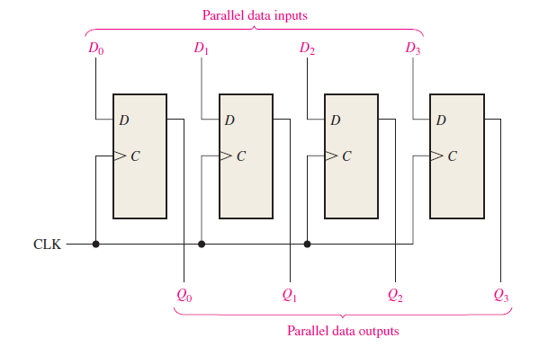
Parallel In Parallel Out

Slide 18
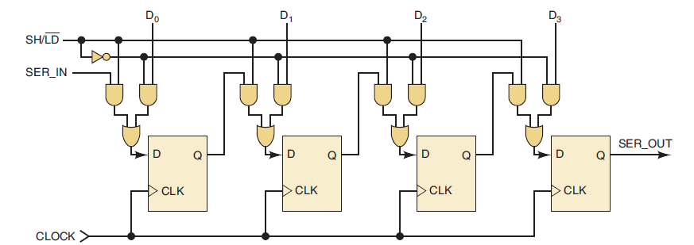
Parallel In Serial Out

Slide 19
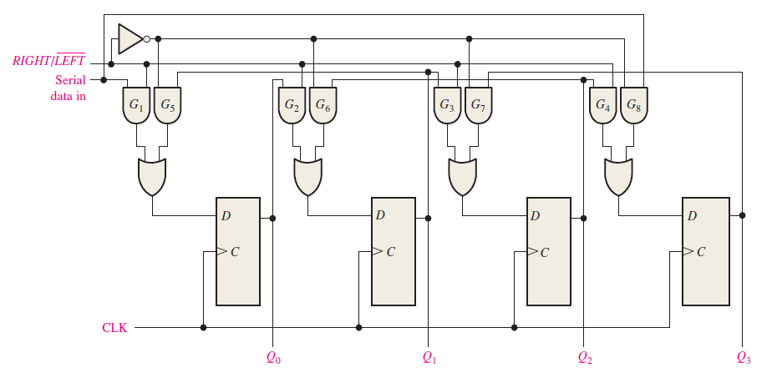
Bidirectional Shift Register

Slide 20
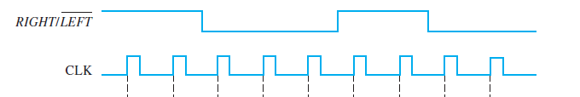
Concept Check
Assume that Q0 = 1, Q1 = 1, Q2 = 0, and Q3 = 1 and that the serial data-input line is LOW. Determine the state of the shift register

Slide 21
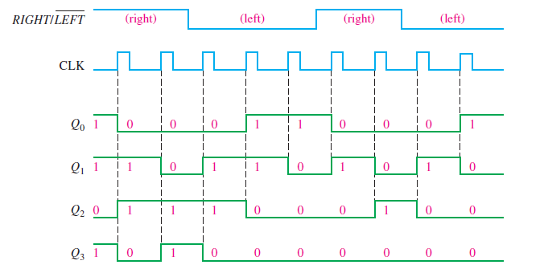
Solution

Slide 22
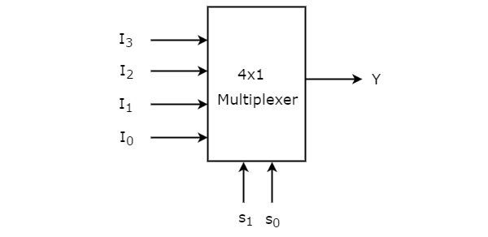
Multiplexer

Slide 23
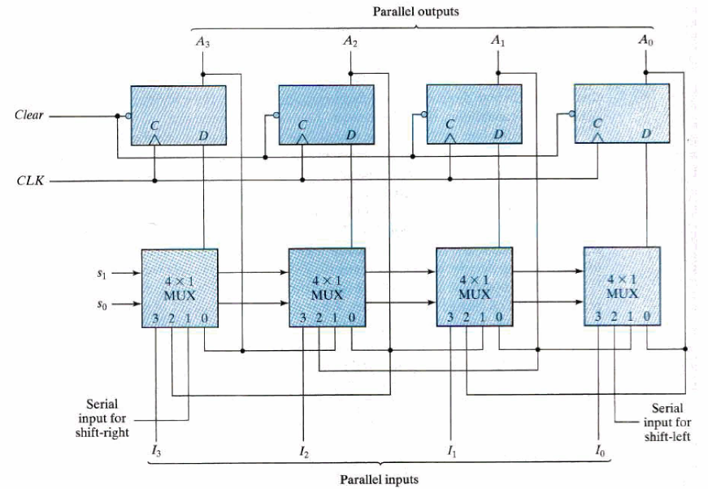
Universal Shift Register

Slide 24
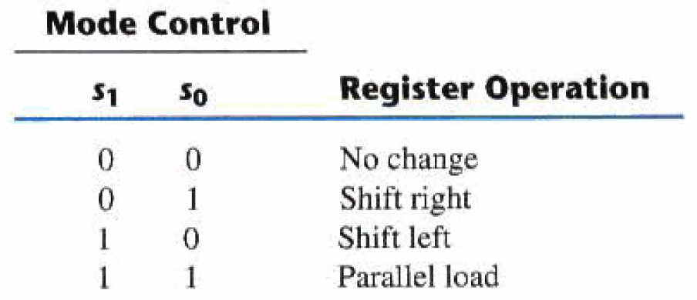
Modes (Universal Shift Register)

Slide 25
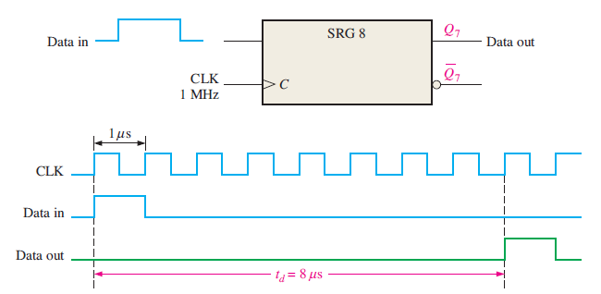
Register For Time Delay

Slide 26
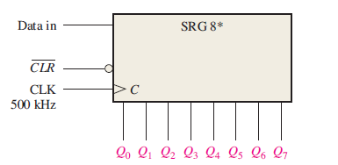
Concept Check

Slide 27
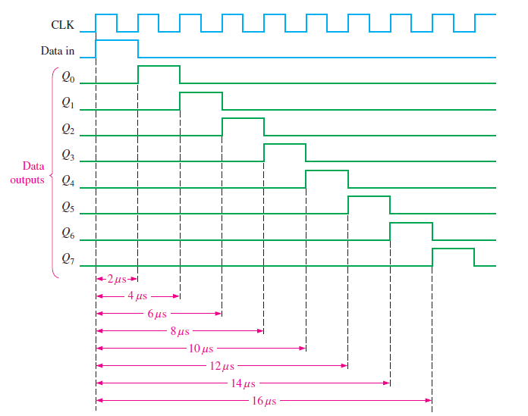

Slide 28
Counters
Ripple/Asynchronous/Serial Counters
Cascaded arrangement of Flip-Flops where the output of one Flip-Flop drives the input of the following Flip-Flop.
The clock input to any subsequent flip-flop comes from the output of its immediately preceding flip-flop. For instance, the output of the first flip-flop acts as the clock input to the second flip-flop, the output of the second flip-flop feeds the clock input of the third flip-flop and so on.
The modulus (MOD number) of a counter is the number of unique states it goes through before it comes back to the initial state to repeat the count sequence.
An n-bit counter that counts through all its natural states and does not skip any of the states has a modulus of 2n.
We can see that such counters have a modulus that is an integral power of 2, that is, 2, 4, 8, 16 and so on.
These can be modified with the help of additional combinational logic to get a modulus of less than 2n.

Slide 29
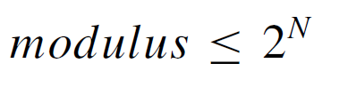
Modulus
To determine the number of flip-flops required to build a counter having a given modulus, identify the smallest integer m that is either equal to or greater than the desired modulus and is also equal to an integral power of 2. For instance, if the desired modulus is 10, which is the case in a decade counter, the smallest integer greater than or equal to 10 and which is also an integral power of 2 is 16. The number of flip-flops in this case would be 4, as 16 = 24.

Slide 30
Concept Check
It is desired to design a binary ripple counter that is capable of counting the number of items passing on a conveyor belt. Each time an item passes a given point, a pulse is generated that can be used as a clock input. If the maximum number of items to be counted is 6000, determine the number of flip-flops required.

Slide 31
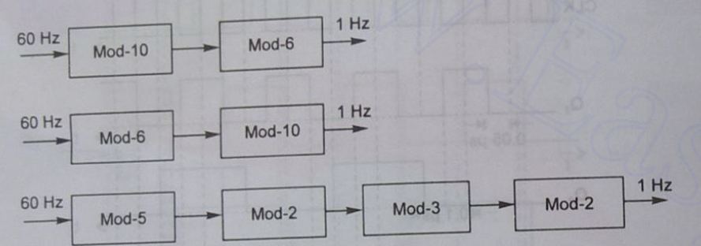
Concept of Frequency Division

Slide 32
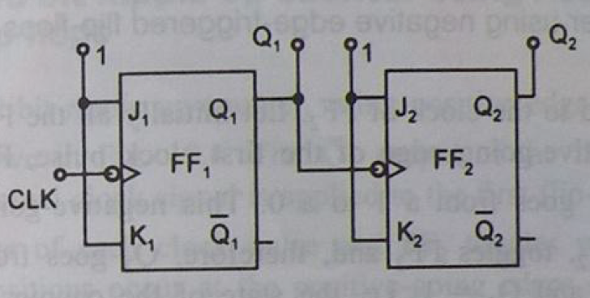
2 Bit NET Up Counter

Slide 33
2 Bit NET Up Counter
Clock Pulse | Q2 | Q1
0 | 0 | 0
1 | 0 | 1
2 | 1 | 0
3 | 1 | 1
4 | 0 | 0

Slide 34
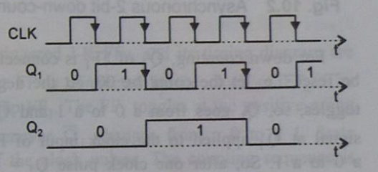

Slide 35
3 – Bit NET Up Counter
Clock Pulse No. | Q3 | Q2 | Q1
0 | 0 | 0 | 0
1 | 0 | 0 | 1
2 | 0 | 1 | 0
3 | 0 | 1 | 1
4 | 1 | 0 | 0
5 | 1 | 0 | 1
6 | 1 | 1 | 0
7 | 1 | 1 | 1
8 | 0 | 0 | 0

Slide 36
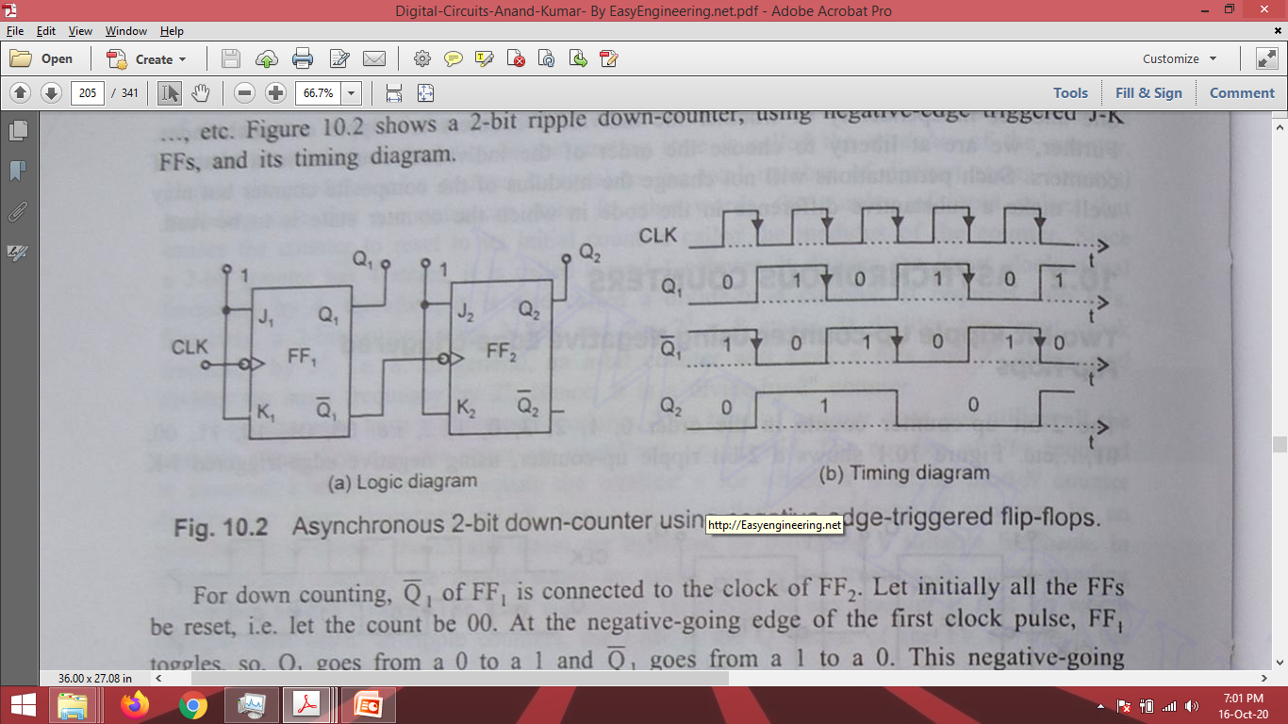
2 – Bit NET Down Counter

Slide 37
2 – Bit NET Down Counter
Clock Pulse | Q2 | Q1 | Q1’
0 | 0 | 0 | 1
1 | 1 | 1 | 0
2 | 1 | 0 | 1
3 | 0 | 1 | 0
4 | 0 | 0 | 1

Slide 38
2 – Bit NET Down Counter

Slide 39
3 – Bit NET Down Counter
Clock Pulse No. | Q3 | Q2 | Q2’ | Q1 | Q1’
0 | 0 | 0 | 1 | 0 | 1
1 | 1 | 1 | 0 | 1 | 0
2 | 1 | 1 | 0 | 0 | 1
3 | 1 | 0 | 1 | 1 | 0
4 | 1 | 0 | 1 | 0 | 1
5 | 0 | 1 | 0 | 1 | 0
6 | 0 | 1 | 0 | 0 | 1
7 | 0 | 0 | 1 | 1 | 0
8 | 0 | 0 | 1 | 0 | 1

Slide 40
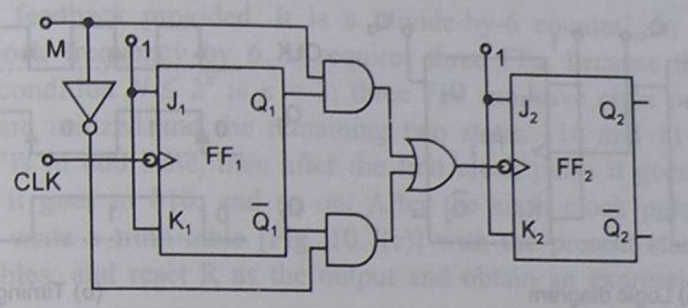
2-Bit NET UP/Down Counter

Slide 41
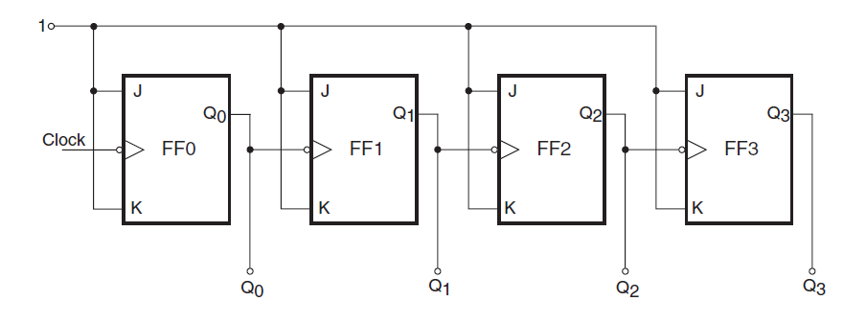
Predict the Output States

Slide 42
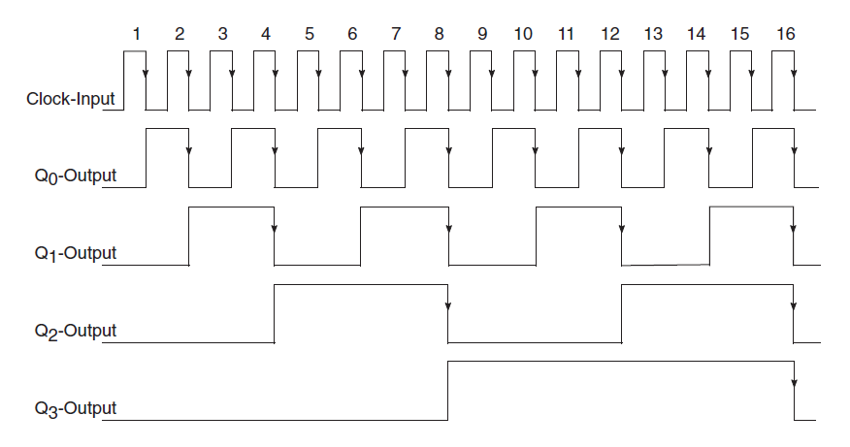

Slide 43
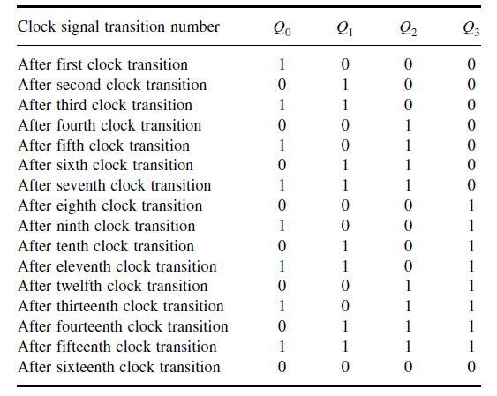
Truth Table / Output States

Slide 44
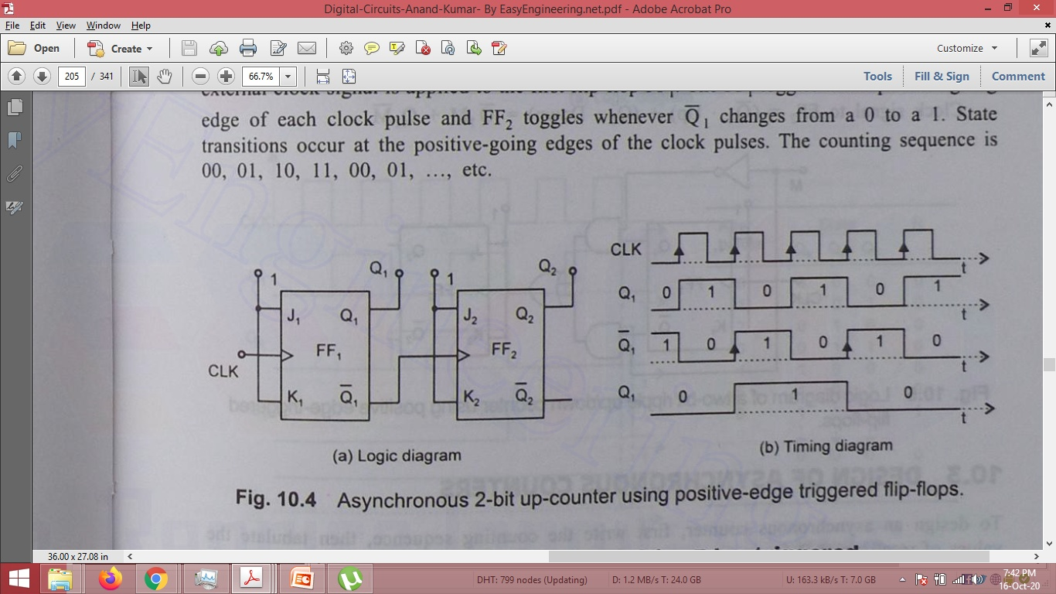
2 – Bit PET Up Counter

Slide 45
2 – Bit PET Up Counter
Clock Pulse | Q2 | Q1 | Q1’
0 | 0 | 0 | 1
1 | 0 | 1 | 0
2 | 1 | 0 | 1
3 | 1 | 1 | 0
4 | 0 | 0 | 1

Slide 46
2 – Bit PET Up Counter

Slide 47
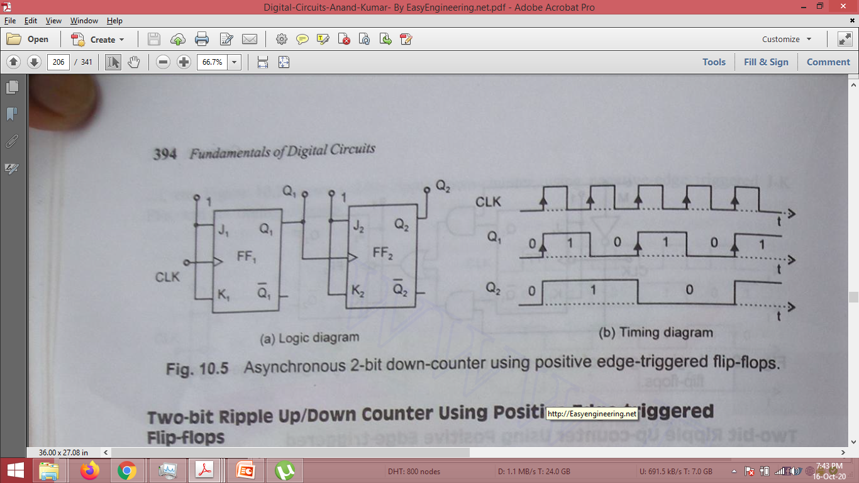
2 – Bit PET Down Counter

Slide 48
2 – Bit PET Down Counter

Slide 49
2 – Bit PET Down Counter
Clock Pulse | Q2 | Q1
0 | 0 | 0
1 | 1 | 1
2 | 1 | 0
3 | 0 | 1
4 | 0 | 0

Slide 50
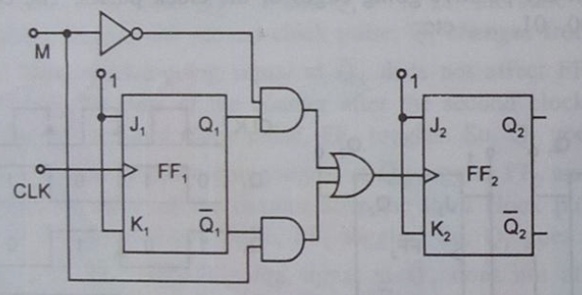
2 – Bit PET Up/Down Counter

Slide 51
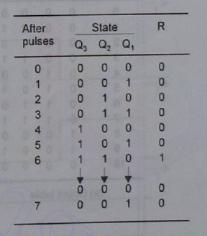
Mod – 6 Counter Design

Slide 52
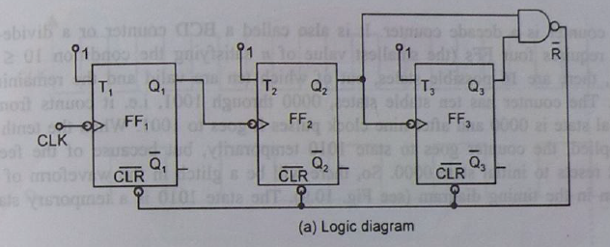
Mod – 6 Counter

Slide 53
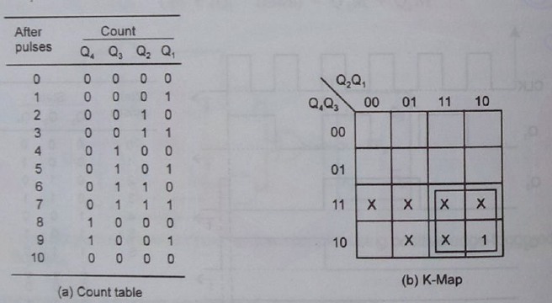
Mod – 10 Asynchronous Counter

Slide 54
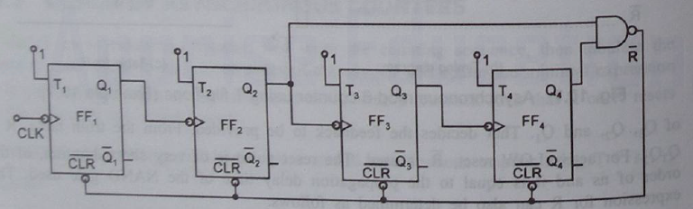
Mod – 10 Counter

Slide 55
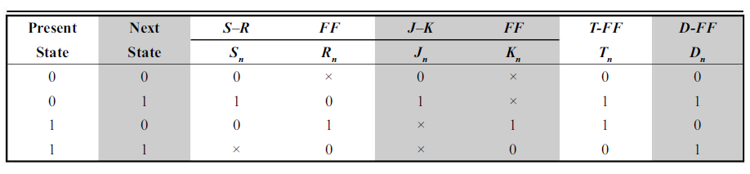
Excitation Tables

Slide 56
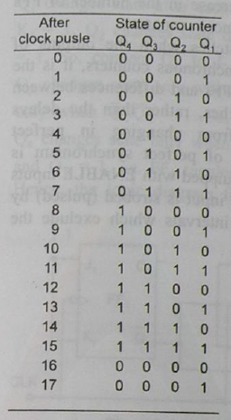
4 – Bit Up Counter

Slide 57
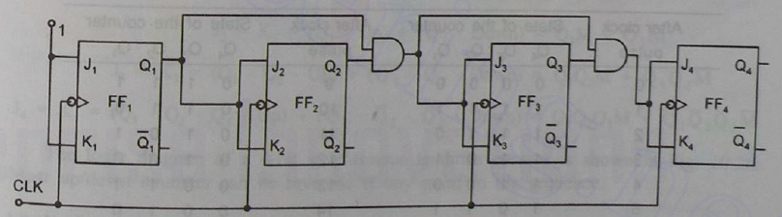
4 – Bit Up Counter

Slide 58
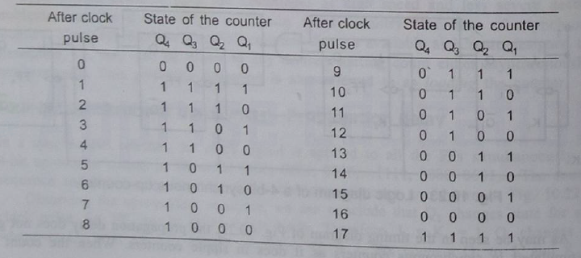
4 – Bit Down Counter

Slide 59
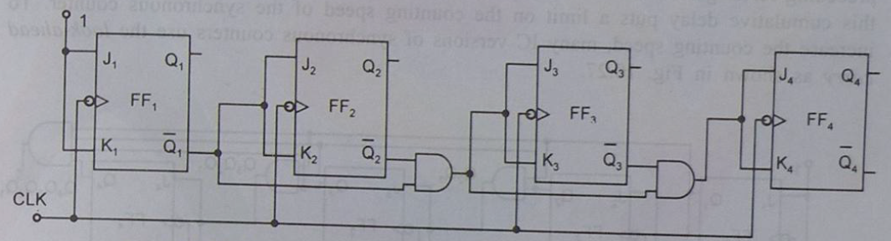
4 – Bit Down Counter

Slide 60

4 – Bit UP/DOWN Counter

Slide 61

Mod < 2^n

Slide 62


Mod – 6 SC

Slide 63

State Transition Diagram

Slide 64
Propagation Delay

Slide 65


Slide 66



Slide 67
Concept Check
A certain J-K flip-flop has tpd = 12 ns. What is the largest MOD counter that can be constructed from these FFs and still operate up to 10 MHz?

Slide 68


Advantage of SC over ASC

Slide 69

Concept Check
Determine fmax for the synchronous counter of Figure above if tpd for each FF is 50 ns and tpd for each AND gate is 20 ns. Compare this value with fmax for a MOD-16 ripple counter.

Slide 70

Solution

Slide 71

Synchronous Counter Design

Slide 72

State Diagram

Slide 73

Next State Table

Slide 74

Transition Table

Slide 75

K-Map Simplifications

Slide 76

Flip-Flop Inputs

Slide 77

Circuit Implementation

Slide 78

Design Summary

Slide 79

3 – Bit UP Counter

Slide 80

3 – Bit UP Counter

Slide 81

3 – Bit UP Counter

Slide 82

3 – Bit DOWN Counter

Slide 83

3 – Bit DOWN Counter

Slide 84

3 – Bit DOWN Counter

Slide 85
To B Continued…

